Slide 1
GCSE Coursework – Ma Ville
Vendredi, 24 avril
Learning objective:
To correct the first three section of coursework and write the section.

Slide 2
At home and abroad
Coursework description:
Letter to exchange school stating facilities (sport, cultural, amusements) in your area.
Task:
To write a letter or an e-mail to a student in an exchange school describing your town, what it is like and what there is to do there.

Slide 3
What should we include?
Imagine that you are writing to an exchange partner from a French school. Before their visit to the UK, they want to know more about your town. In your letter or e-mail tell them:
Where you live.
What kind of town you live in.
An opinion about your town.
What there is/isn’t in your town and what you can do there.
What you did last weekend.
What you will do next weekend.

Slide 4

How will we do it?
This week:
Write as much as we can from points 1 to 4 in our exercise books.
Next week:
Recap past tense and future tense – add into coursework.
Correct examples of mistakes together.
Correct own work.
Write up in neat.

Slide 5

Can you reach the top of the tower?
Today we are working towards
completing levels 1 – 4 on the tower!

Slide 6
Correction Checklist
Accents
Spellings
Endings
Verbs
Is the whole sentence there?

Slide 7
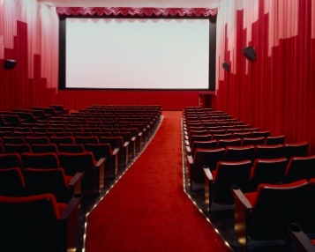
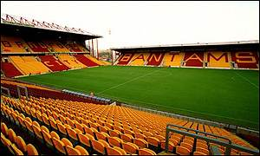
Qu’est-ce qu’il y a dans ta ville?
Dans ma ville, il y a un cinéma où on peut voir un film
Dans ma ville, il y a stade un où on peut voir un match de foot

Slide 8

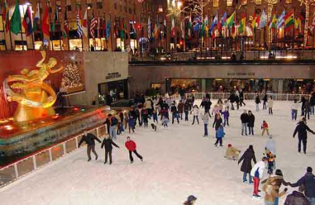

Qu’est-ce qu’il y a dans ta ville?
Dans ma ville, il y a un supermarché où on peut faire les courses
Dans ma ville, il y a une patinoire où on peut faire le patinage
Dans ma ville, il y a une piscine
où peut faire la natation!

Slide 9
On peut…
You can
faire
les courses - go shopping
un promenade - go for a walk
la natation - go swimming
aller
à la piscine - go to the swimming pool
au cinéma - go to the cinema
au stade - go to the stadium
à la patinoire - go to the ice rink
à la boulangerie - go to the bakery
visiter
une cathédrale - visit a cathedral
un port - visit a port
un château - a castle

Slide 10

Remember!
Include connectives to get higher marks (but, and, because)
Include opinions to get higher marks
Include different tenses to get higher marks
Check your spelling!
Use your book!

Slide 11
Strip Bingo
tranquille
propre
intéressante
animée
jolie
moderne
historique
ennuyeuse
salle
polluée
isolée
loin de tout
bruyante
industrielle
nul

